Slide 1

Kivy Overview
Albuquerque Python Meetup
3/18/2014
Kris Hardy <kris@rkrishardy.com>
http://www.kivy.org

Slide 2
What is Kivy
Cross-Platform “Natural User Interface” Library
  Linux
  Windows
  OS X
  iOS
  Android
Extensive Widget (UI Element) Suite
Event loop
User-contributed Plugins (Kivy Garden)

Slide 3
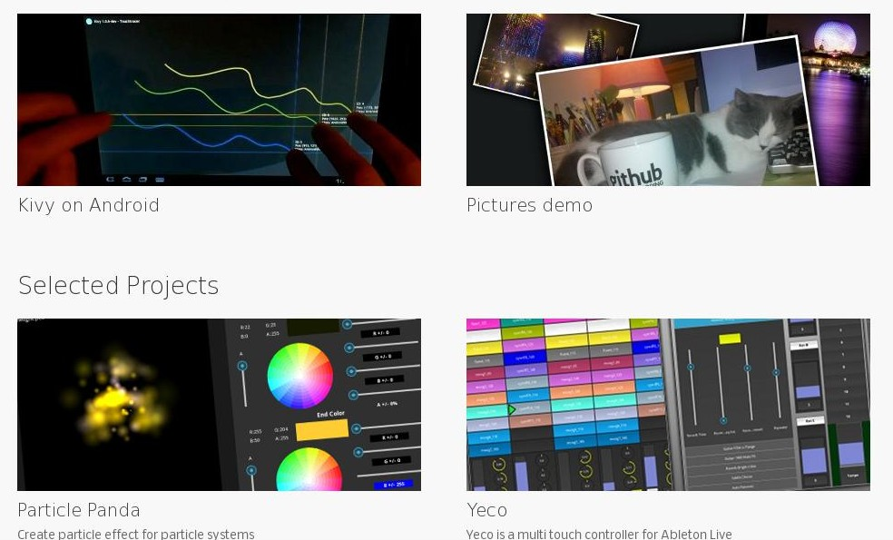
Examples

Slide 4
Core Concepts
Designed for touch
Built-in gesture interpreter
Event-driven
Widget actions are separate from graphics
Uses 3D acceleration if available (OpenGL)
Cross-platform
Rapid Development / Iteration

Slide 5
Widgets
User Interface elements (buttons, text, images, etc.)
Widgets can listen for events and/or emit events
Inter-widget communication done via events
Events are handled asynchronously by the event loop
Widgets can contain other widgets

Slide 6
Event Loop & Broker
Central part of most UI libraries
Allows the UI and logic code to be decoupled
Allows pseudo-“non-blocking” behavior
The framework schedules event dispatching, screen rendering, checking hardware, etc.
Clicked Event
Text Updated
Button
Button Clicked
Event
Broker
Do
Work

Slide 7
Other Cool Things
“Kv” Declarative Language
Particle System
App Contest (April 15th – May 14th)
Recently Ported to Raspberry Pi (Kickstarter project)

Slide 8
Pong Tutorial
Basic Kivy Setup
Adding graphics
Adding motion
Adding interactions

Slide 9
My Project – RH Systems Gen2UI
Embedded system UI using Kivy
Real-time hardware in C, using Real-Time Operating System
Communication between real-time hardware and UI embedded system

Slide 10
A Real-World Example
Embedded System UI
Multiple Threads
Multiple Processes
UI is entirely event driven

Slide 11
My Future Work
Hunt down and fix OpenGL loading problem on Beagle Bone Black & Debian 7
Continue UI Development (complex layouts with translucent overlays)
Graphing library evaluation (garden.graph)
Performance testing
Integration into an RH Systems scientific instrument

Slide 12
Example Source Code at
github.com/krishardy/kivy_intro_20140318

